Slide 2


DMU
Hacking Society
Web Vulnerabilities

Slide 3


Announcements:
DMU HACKERS
Talks: (Enhancement Week)
Peter Clarke, BT Red Team Tuesday 18th November 13:00 – 15:00 Gateway House GH5.39
Allan Cook (Accenture) & Jamie Roderick (LRQA) Breaking the Bad News – Communicating Cybersecurity Incidents with Confidence and Care Gateway House 19th November GH5.39 10:00 – 12:30
Airbus Day 20th November 10:00 – 15:30 Gateway House GH5.39
rgs@dmu.ac.uk - To secure a place on any of the above
Q-Zips order inbound, stand by for that one

Slide 4
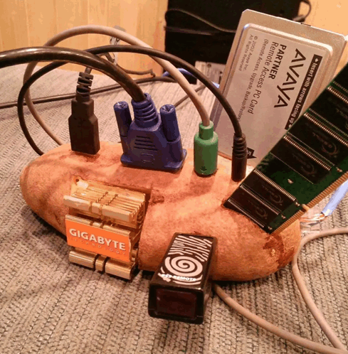
SSRF
DMU HACKERS
Server-Side request forgery
Targets and tricks the server directly into making requests to internal or external resources
Can be used to gain access to restricted subdomains
Scan devices on the internal network

Slide 5
CSRF
DMU HACKERS
Cross-site request forgery
Attacker sends malicious link, victim clicks on it, exploiting their authenticated session
Force the end user to perform state changing processes, such as initiating transactions, changing email addresses and passwords etc…
Server processes the user actions as legitimate

Slide 6
CSRF - Prevention
DMU HACKERS
Anti-CSRF tokens-require a unique set of values for each request, which then must be verified by the server-side before processing the request
Use Same Site cookie attribute-restrict cookies from being sent with cross-site requests

Slide 7
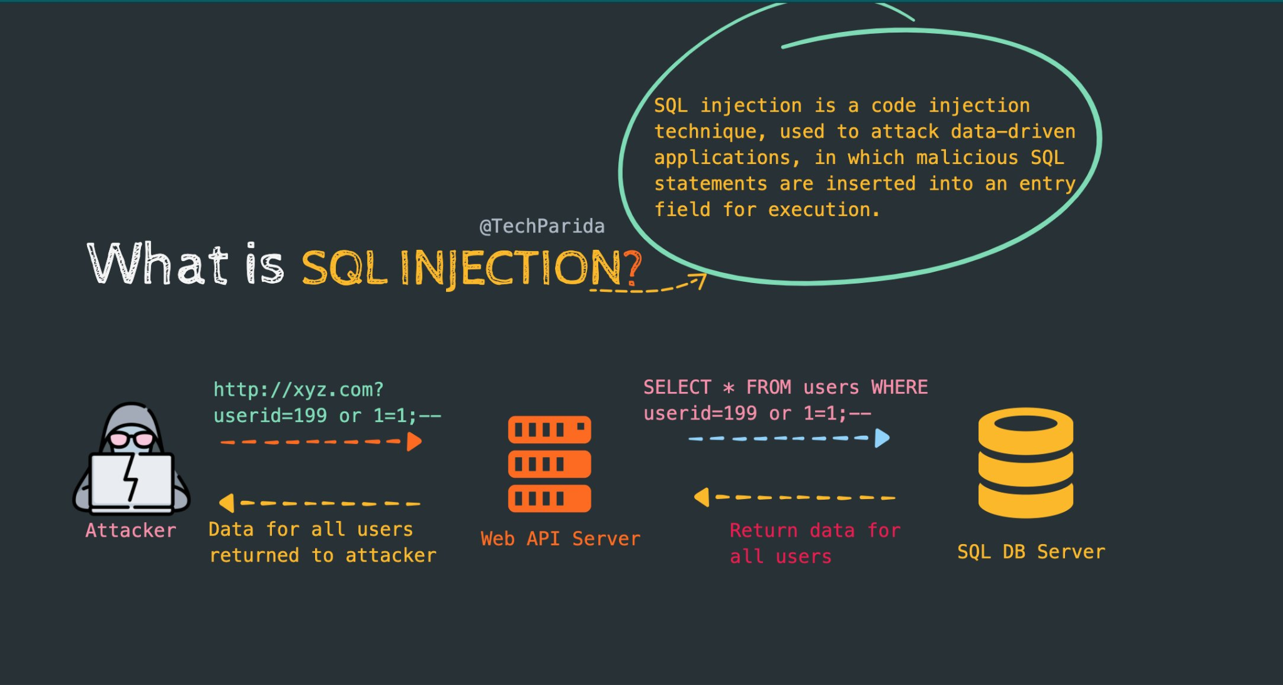
DMU HACKERS

Slide 8
SQLi
DMU HACKERS
Standard Query Language Injection
Manipulating database queries by injecting malicious SQL code into applications
input validation and allowlists to prevent unvalidated user input from being added to the SQL query
Escape user inputs before allowing them to be queried

Slide 9
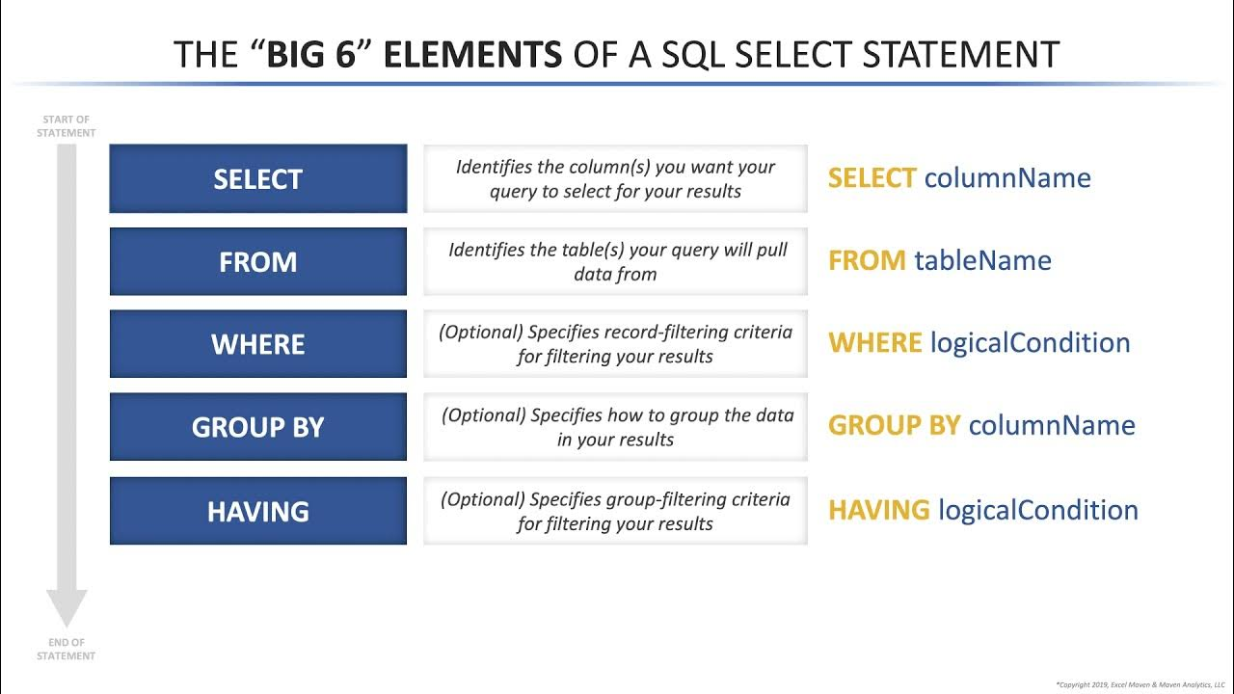
DMU HACKERS

Slide 10
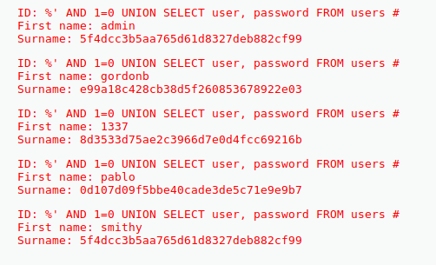
SQLi- Examples
DMU HACKERS
SELECT *
FROM users
WHERE username = 'administrator'--' AND password = ‘’
‘ UNION SELECT username, password
FROM users--

Slide 11
OOB SQLi
DMU HACKERS
Out-Of-Band SQL injection
When an adversary is unable to use the same communication channel to launch the attack and gather the result, they exploit the database’s ability to make DNS or HTTP requests to deliver data to a compromised/attacker-controlled server
Attacker injects SQL which causes the database to ‘leak’ data to an attacker owned server via URL or headers, essentially acting as a beacon

Slide 12
Fuzzing
DMU HACKERS
Feeding/testing programs/services with invalid, random or unexpected data to observe how it behaves
Essentially brute forcing - Chaotic probing to see what breaks and works in a system
“Throw shit at a wall and see what sticks”- Someone or other

Slide 13
XSS
DMU HACKERS
Cross-site scripting
Injection of malicious javascript which is then executed by the victims browser
Can be used to steal data, hijack sessions or manipulate page content

Slide 14
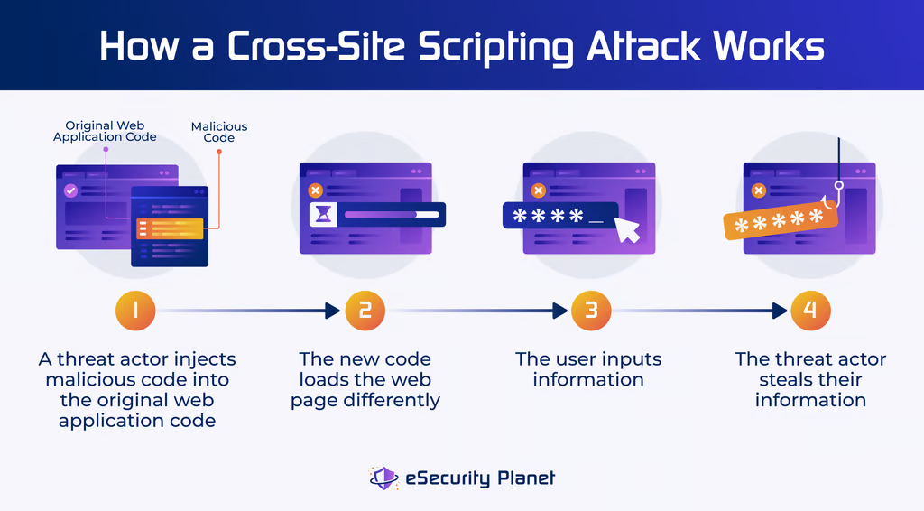
DMU HACKERS

Slide 15
Three main types of XSS
DMU HACKERS
Reflected(Non-Persistent):
data is reflected off the server and shown to the user in the response, typically triggered in the URL parameter
https://___.com/search?q=<script>alert(‘....’)</script>
Stored(Persistent):
The payload is permanently stored on the server, affecting every user who views the compromised web page
DOM-Based(Type-0):
client-side script modifies the Document Object Model in the victim’s browser. Does not require a server response to execute the attack

Slide 16
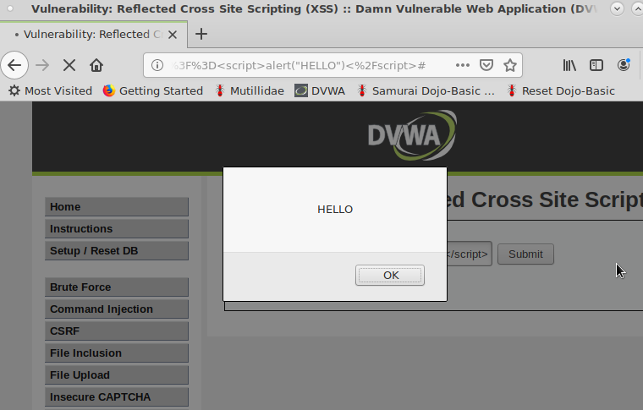
DMU HACKERS
Reflected XSS
Example:
<script>alert(“HELLO”)</script>

Slide 17
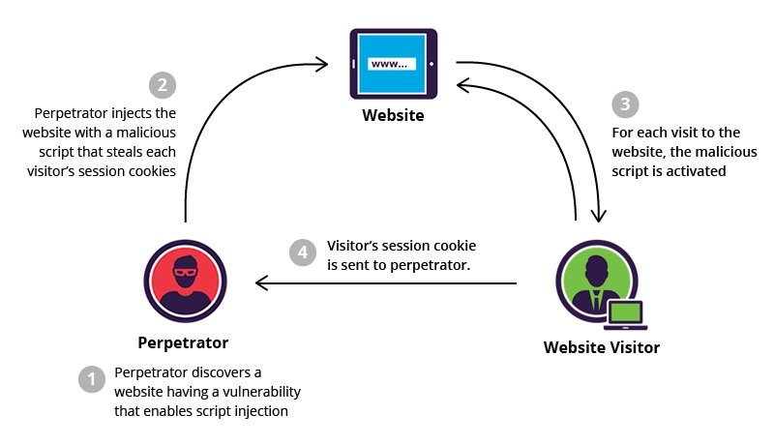
DMU HACKERS
Stored XSS

Slide 18
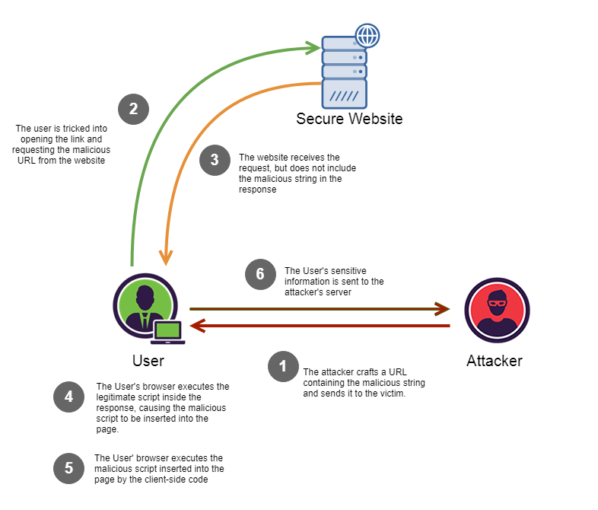
DMU HACKERS
DOM Based XSS

Slide 19
Local File Inclusion (LFI)
DMU HACKERS
Examples:
../../../../etc/passwd
https://example.com?include=../../etc/group
Prevention:
Sanitize inputs
Whitelist allowed files

Slide 20


Tools - Burp Suite
DMU HACKERS
Web vulnerability scanner and testing tool for identifying and exploiting security flaws in web applications
Act as a MiTM proxy between your browser and the target
Intercept, inspect and manipulate traffic/data in real time
Key features:
Decoder
Logging
Spider
Proxy
Fuzzing
https://portswigger.net/web-security/

Slide 21


Tools - Caido
DMU HACKERS
A lightweight web security auditing toolkit
Built in Rust, offering speed and safety
Core features:
Interception: capture and modify HTTP requests and responses
Sitemap: automatically builds a visual map of the target application and logs all interactions
Flexible deployment: can be run locally or be deployed in client-server mode for team collaboration

Slide 22
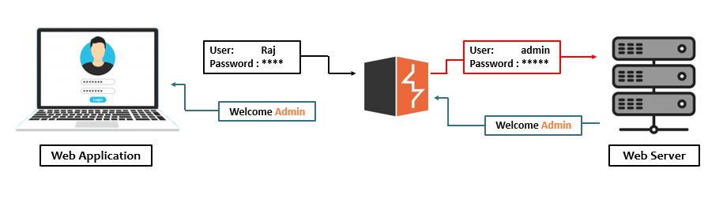
Tools - Burp Suite
DMU HACKERS

Slide 23


Tools - ffuf
DMU HACKERS
Fuzz Faster U Fool
Versatile command-line web fuzzing tool
Used for file discovery, brute-forcing params, wordlists
Example command:
ffuf –w /usr/wordlist.txt –u https://target.com/FUZZ

Slide 24

Tools - gobuster
DMU HACKERS
Command line File Directory brute-forcing tool
Discover hidden content and endpoints on web servers
written in Go, optimised for single level scans
Example command:
gobuster fuzz -u https:/website/FUZZ -w /usr/share/wordlists/…/..

Slide 25

Tools - FeroxBuster
DMU HACKERS
Feroxbuster is a tool designed to perform forced browsing
(Accessing things that are not referenced by the web app)
Written in Rust, Ferric Oxide == Rust
Uses a brute force approach combined with a wordlist to search for unlinked content in target directories. Such as:
Source Code
Directories
Files
Other Resources
Example Command:
feroxbuster --url http://example.com/

Slide 26

Tools - OWASP ZAP
DMU HACKERS
Widely used web scanner that probes underlying security flaws in web applications
Identifies common vulnerabilities (SQLi,XSS, session hijacking, etc..)
Automated Vulnerability scanning
Manual Testing,Discovery and interception of real-time information
Spidering-mimics how search engines index sites, finds hidden or sensitive resources and creates a map of website structures

Slide 27


Tools - SQLMap
DMU HACKERS
Automates the process of detecting and exploiting SQLi flaws in order to gain access to databases
Used for fingerprinting, fetching data, accessing file systems and executing commands via Out-Of-Band connections

Slide 28




Mitigation strategies
DMU HACKERS
Monitoring and Incident response (IR)
Event logs, Alerts
SIEM tools (ElasticSearch, Splunk etc)
Response/recovery plan (IRP)
Authentication and session security (IAM)
Multi-factor Authentication (MFA)
Secure cookies, session timeouts
Physical Keys? Yubikey and similar
Timezone controlled access, other metric checks
Adopt secure coding practices
Input validation, escaping outputs
User Sanitization
Secure by Design (SbD)

Slide 29
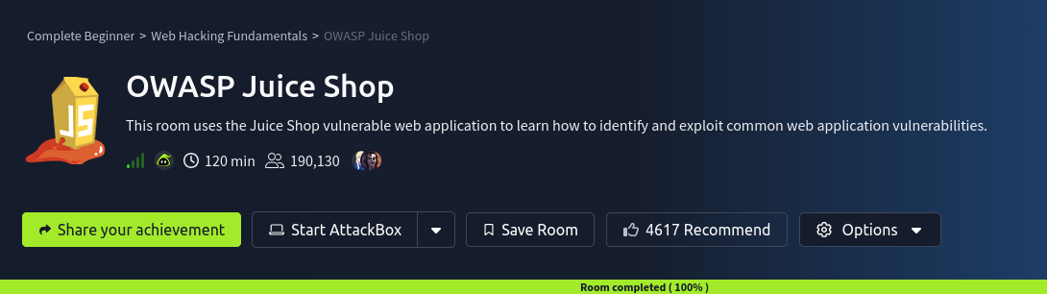
DMU HACKERS
Practical
https://tryhackme.com/room/owaspjuiceshop

